Slide 1
Changing a Font in FrameMaker
Tess Baucom​

Slide 2
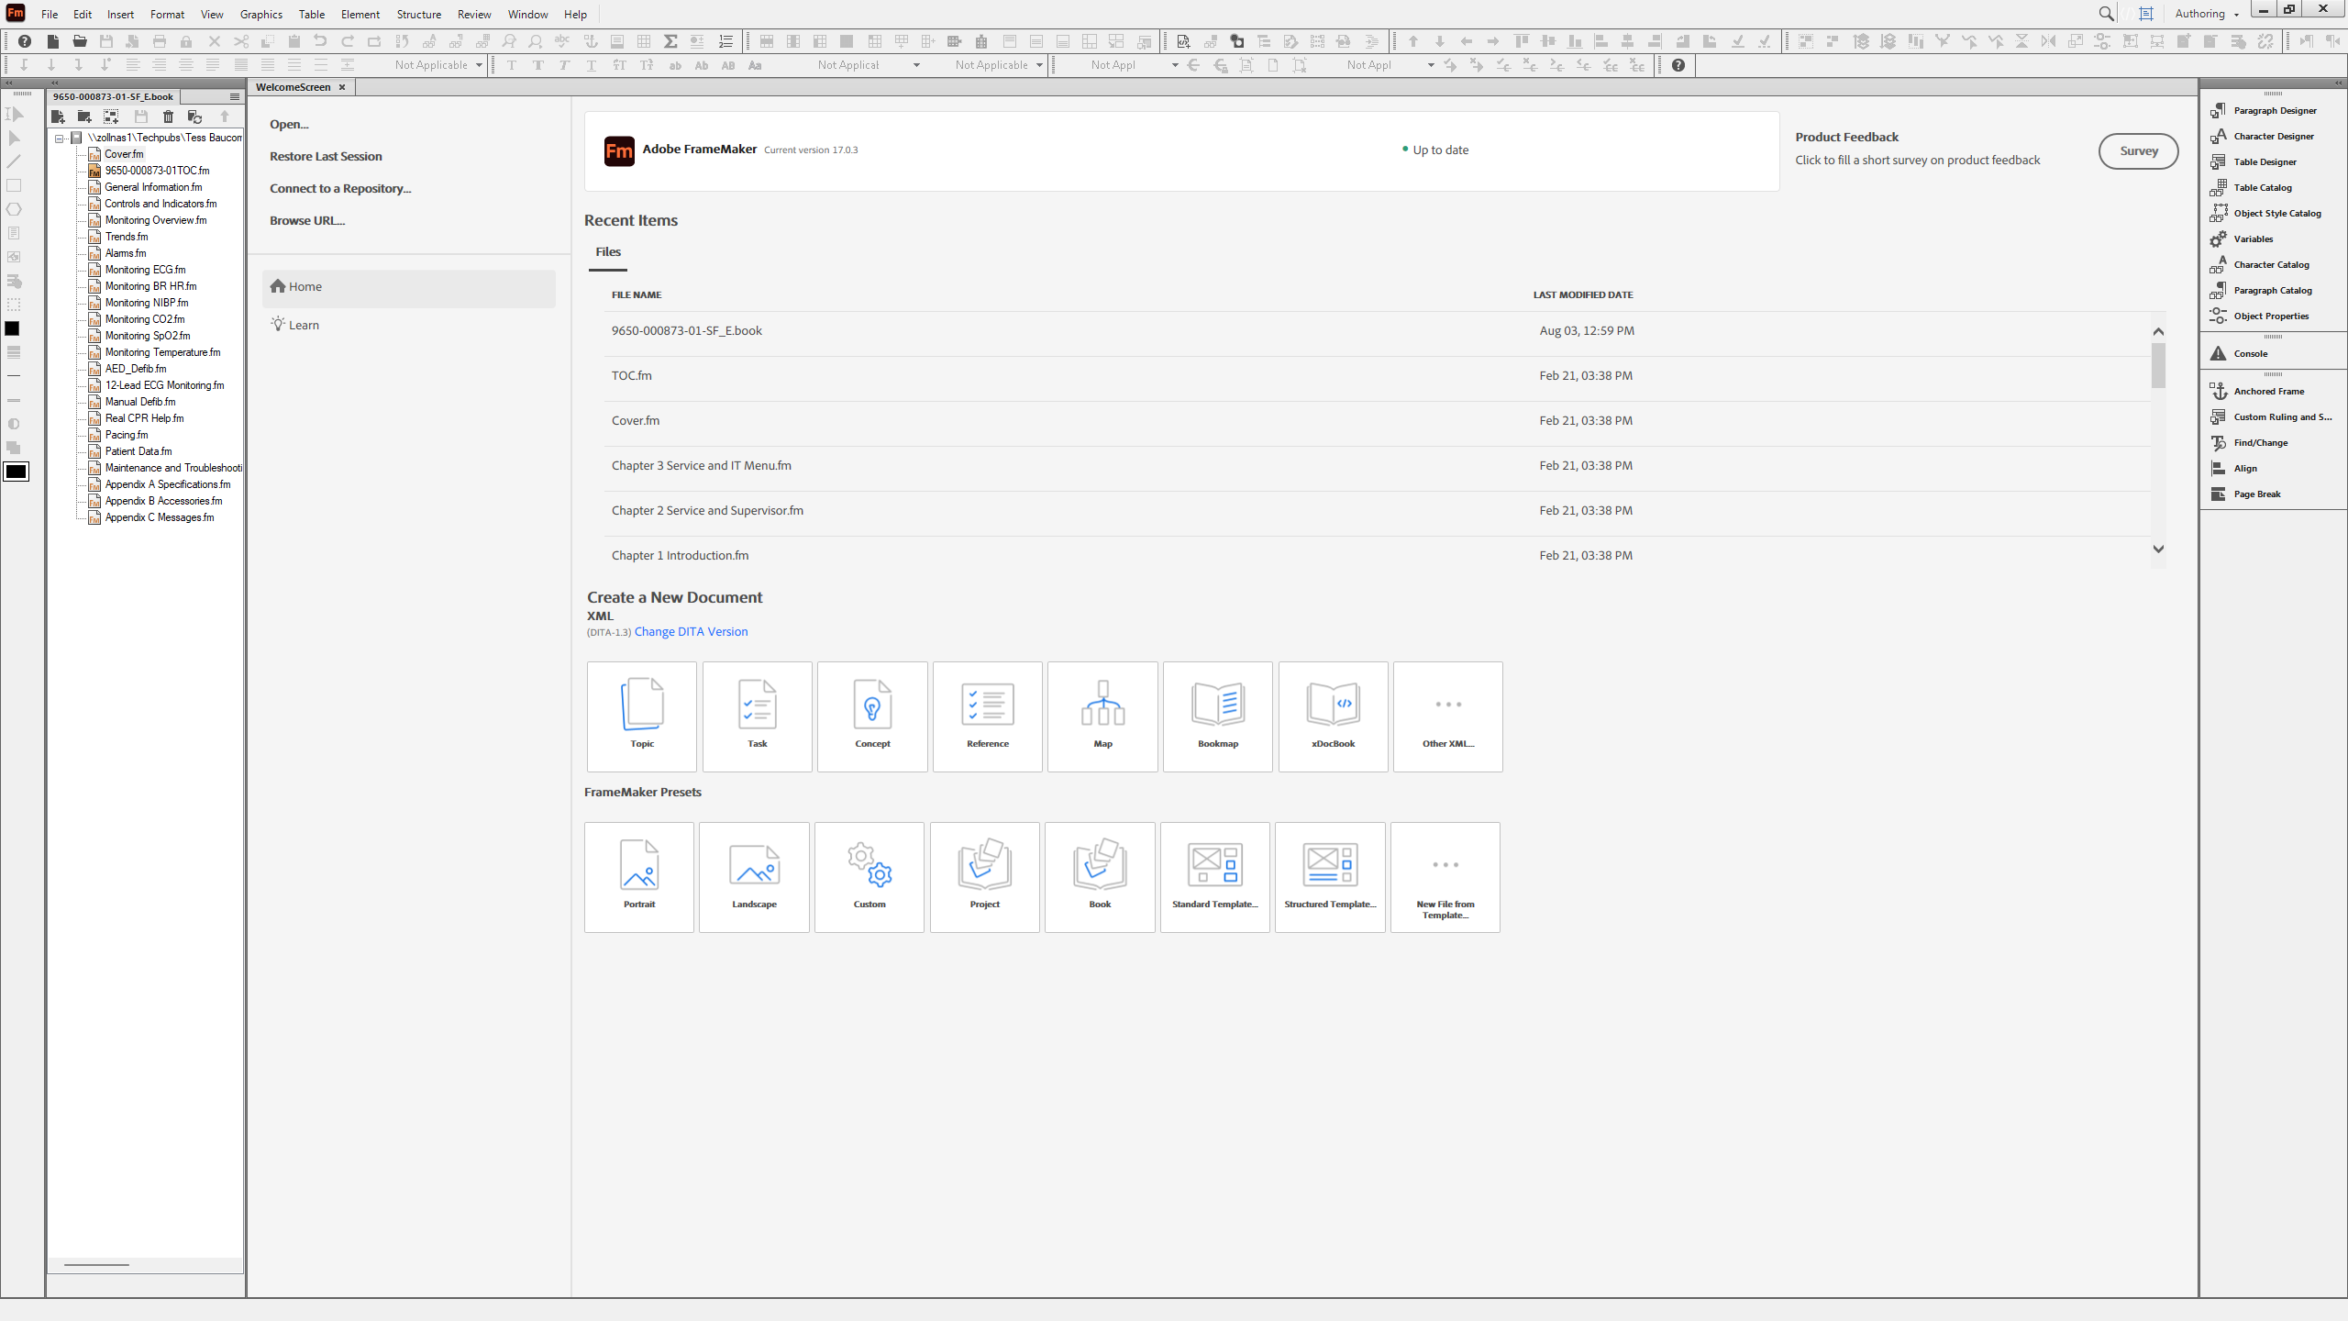
Cover Page
Make sure you select the correct chapter
Back Next End

Slide 3
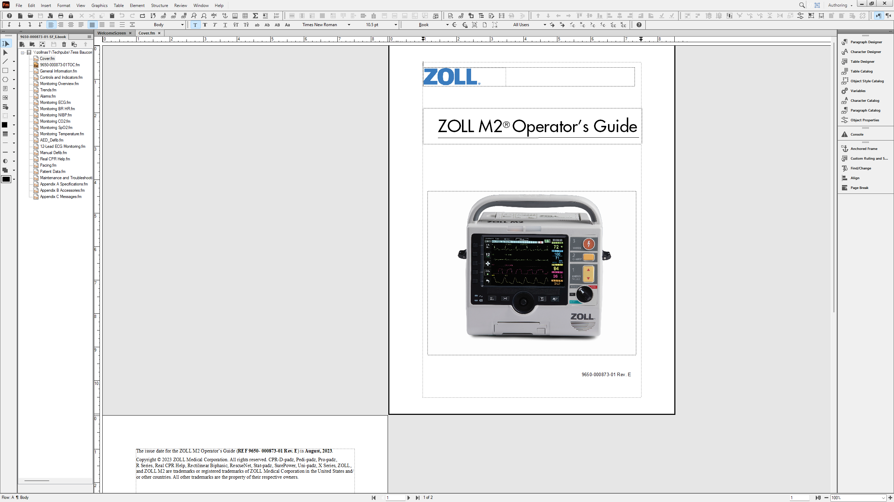
Document Tab
The Cover page document tab opens here
Back Next End

Slide 4
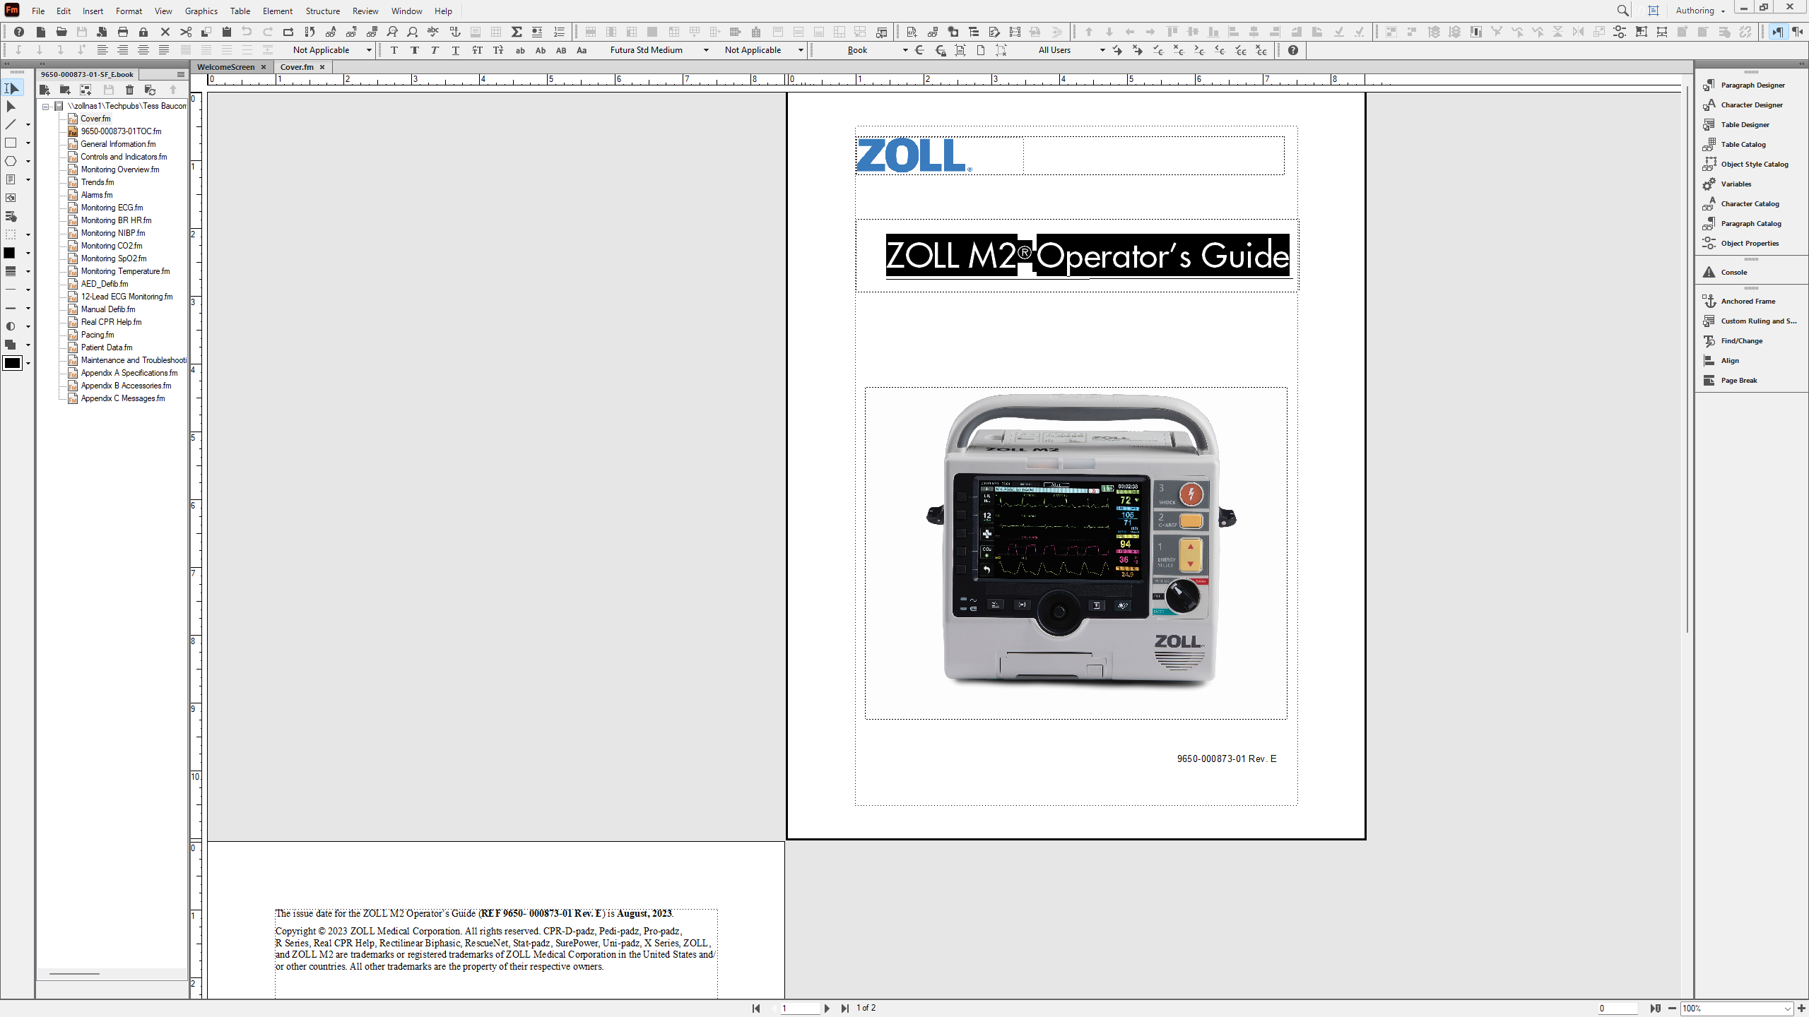
Highlight text
Highlight the text you want to change
Back Next End

Slide 5
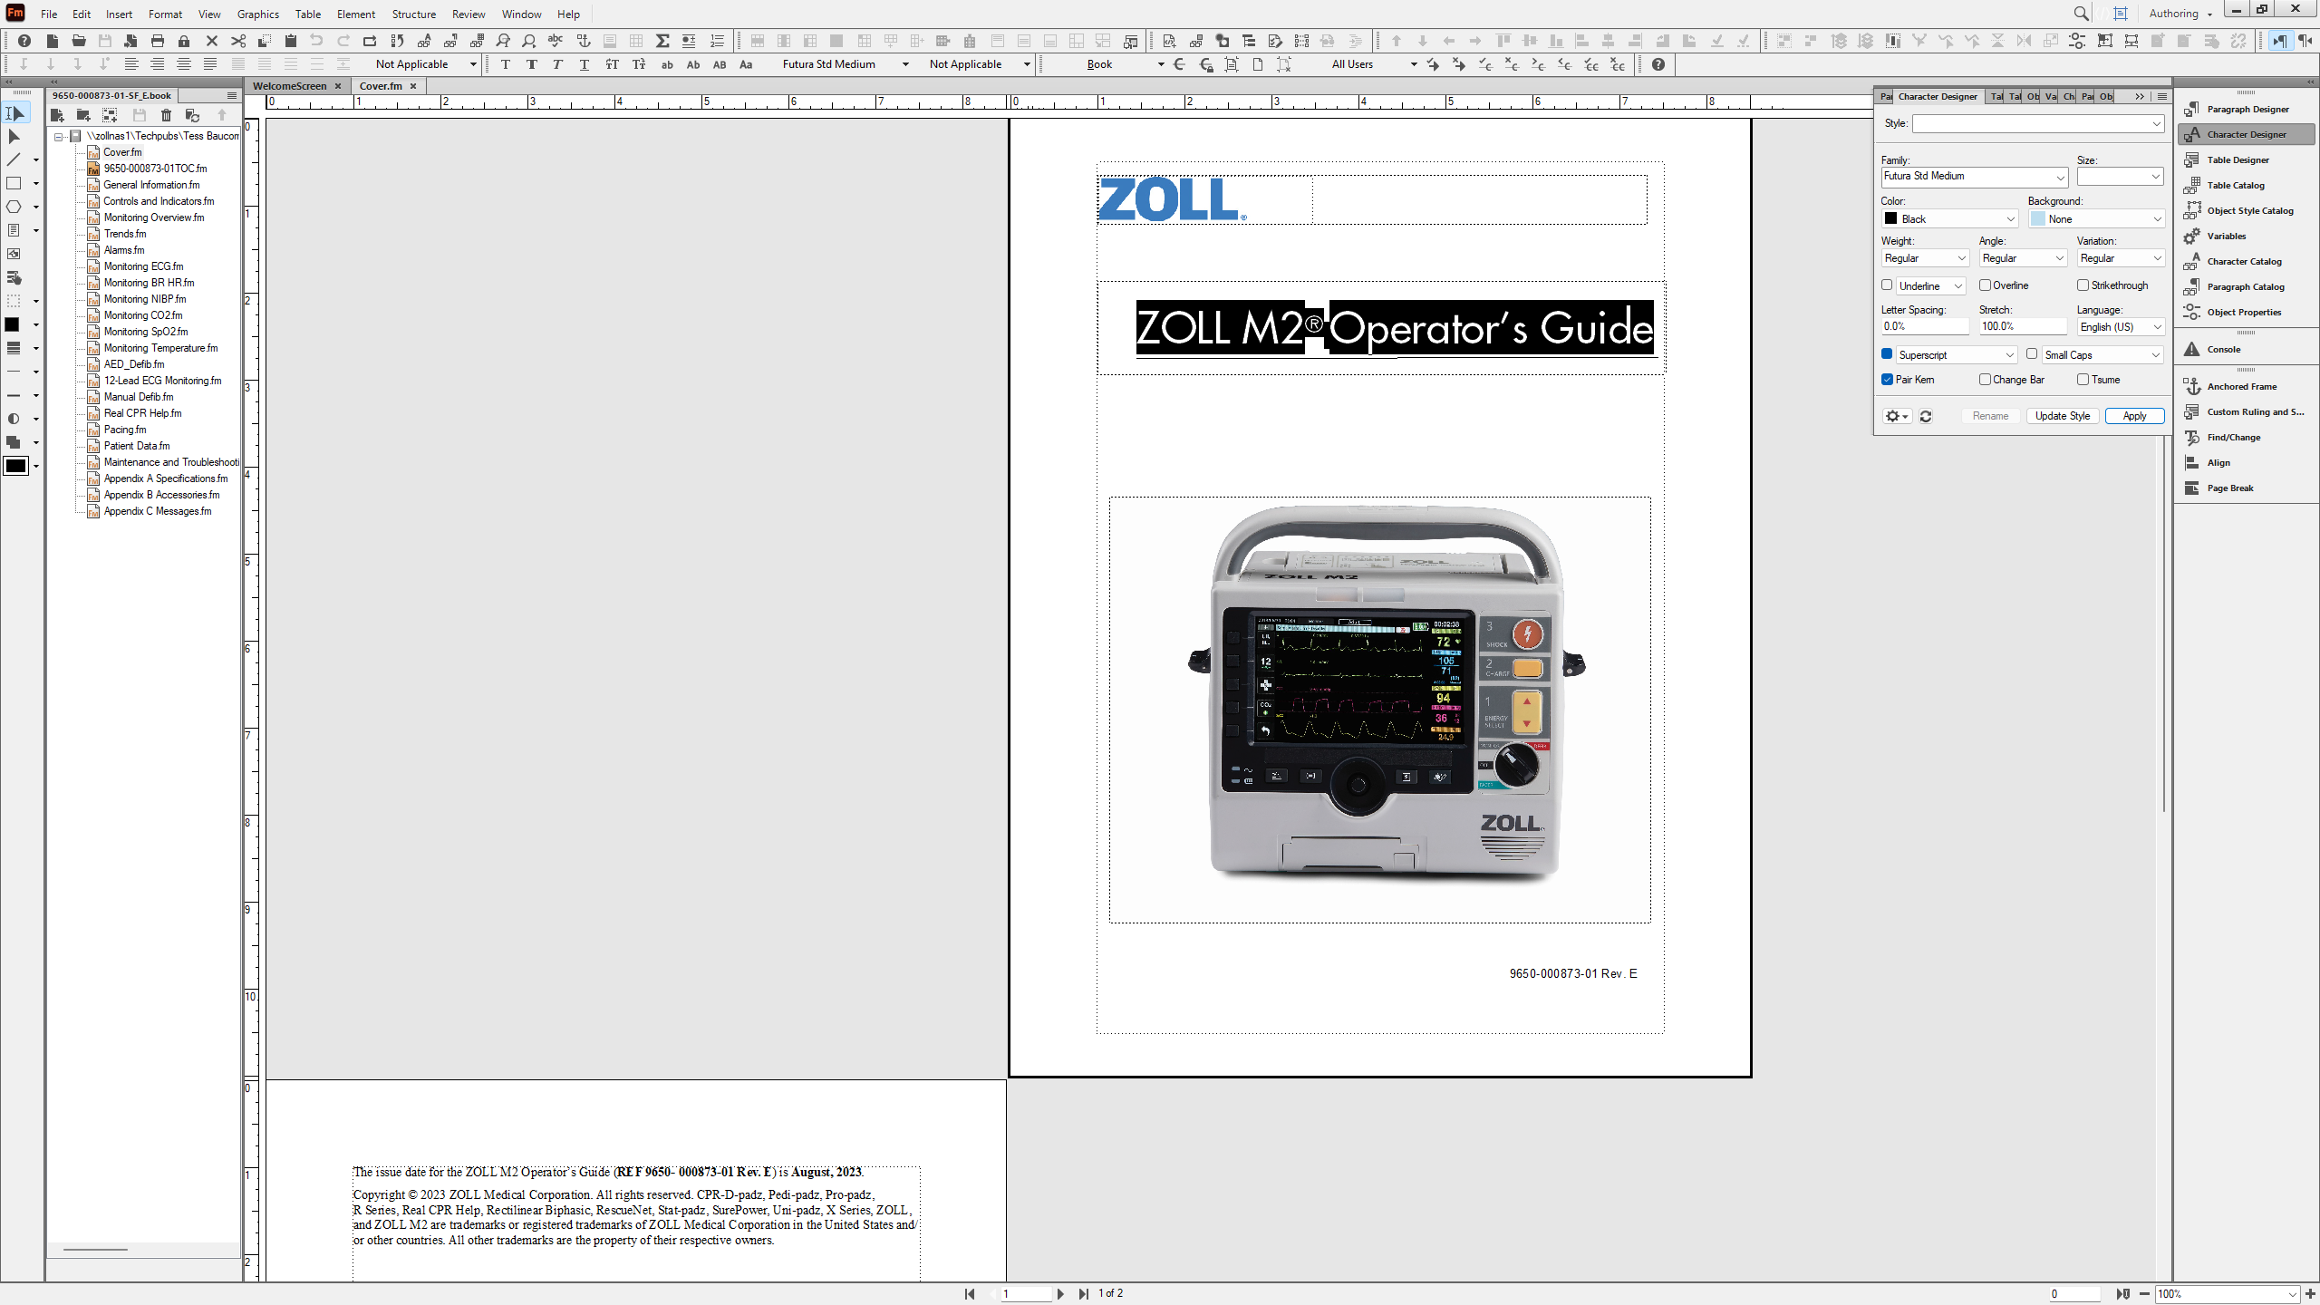
Character Designer
Select the Character Designer panel
Back Next End

Slide 6
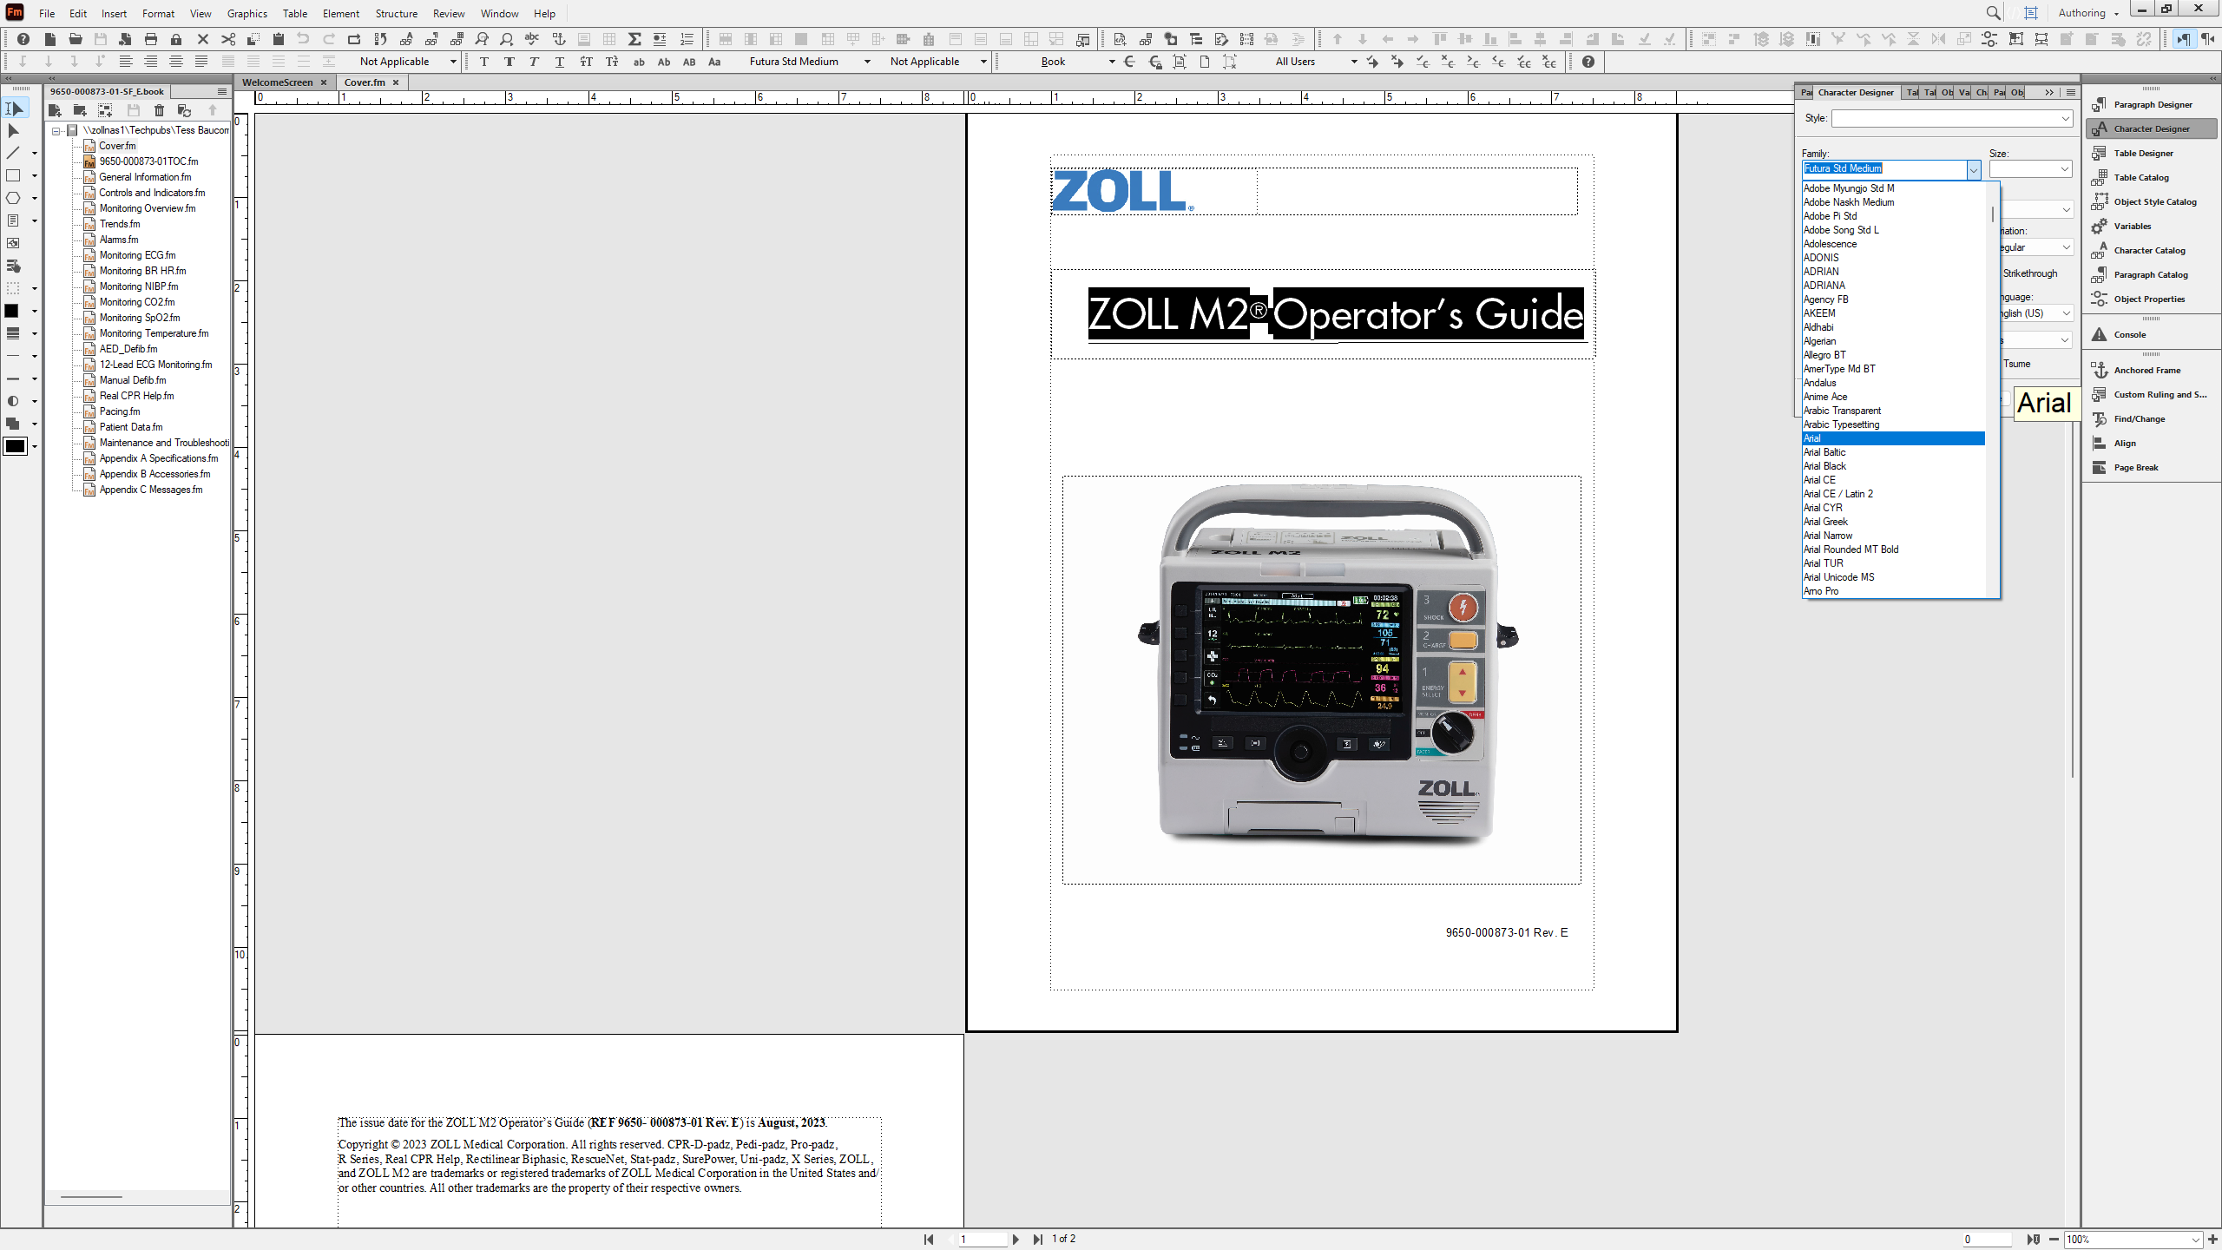
Font Dropdown
Select your desired font family from the dropdown list
Back Next End

Slide 7
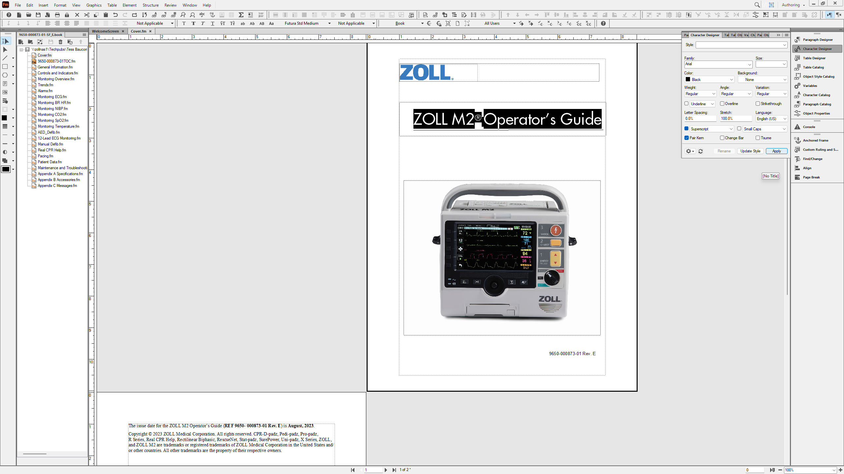
Apply
Select Apply to see the changes to the font
Back Next End

Slide 8
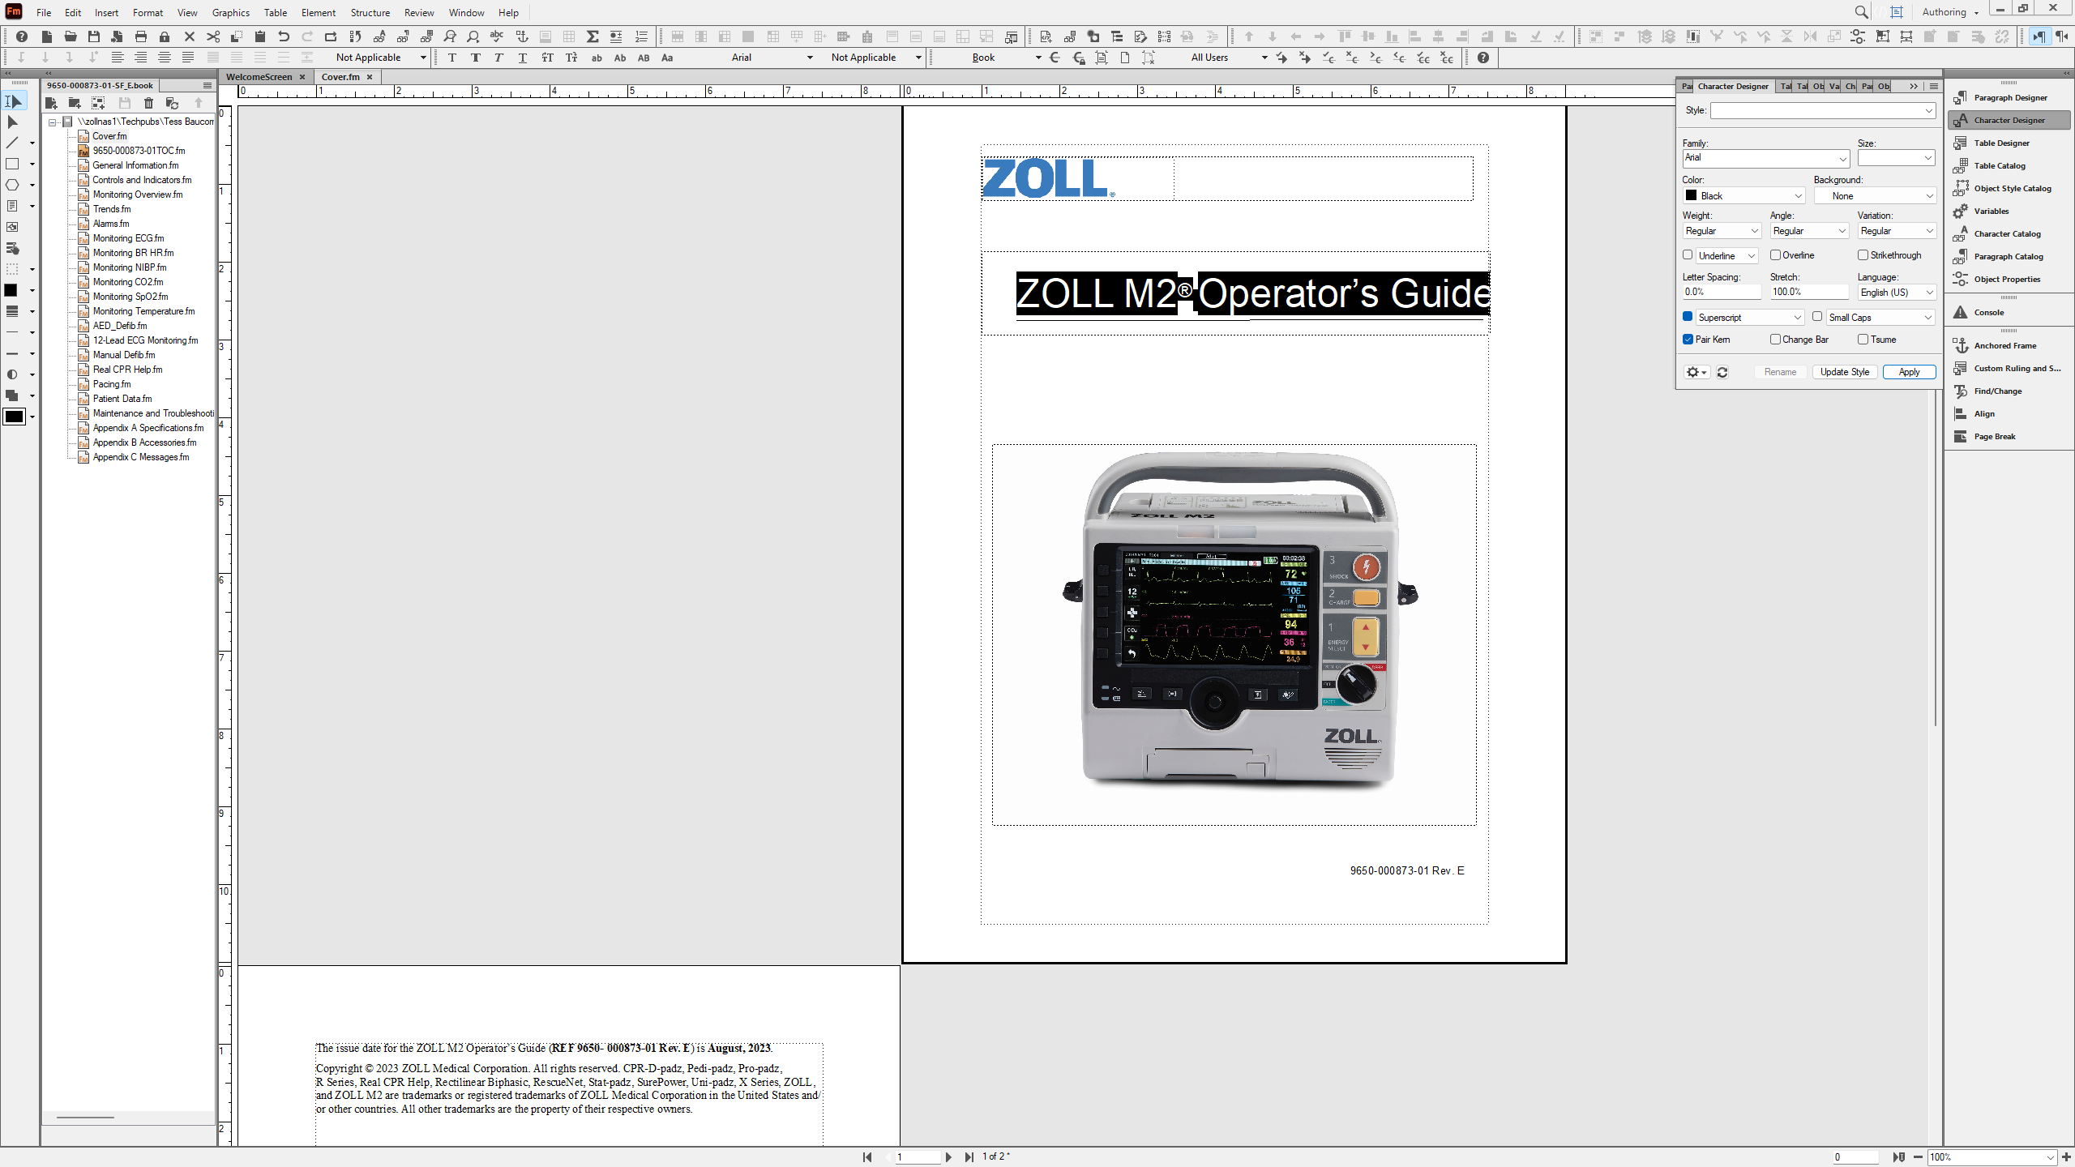
Font Changed
The title font has now changed!
Back Next End

